Slide 1
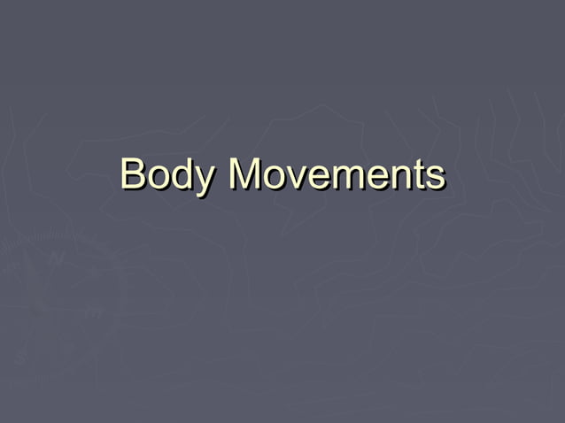
`

Slide 2
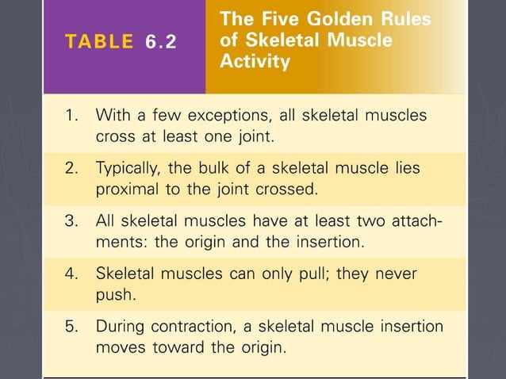

Slide 3
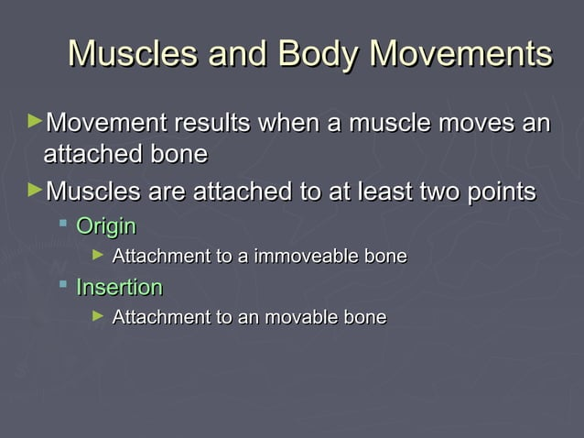

Slide 4
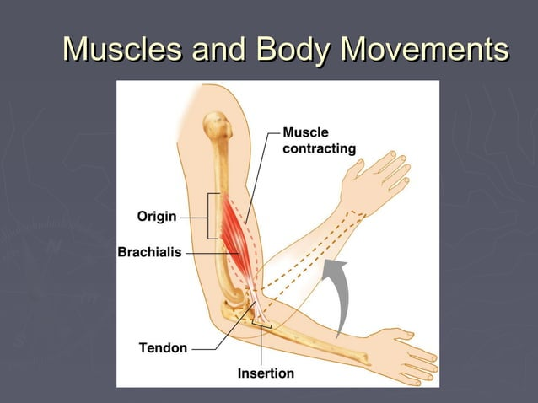

Slide 5
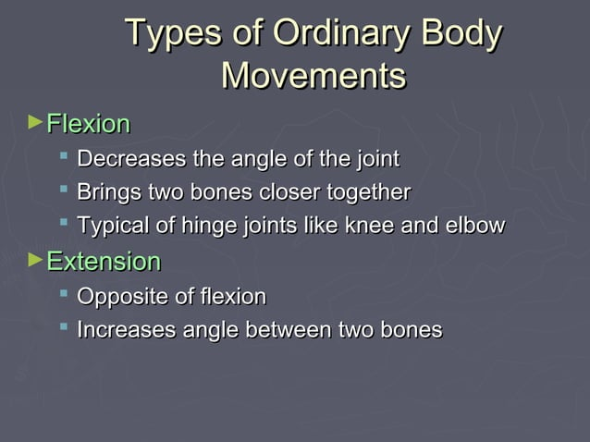

Slide 6
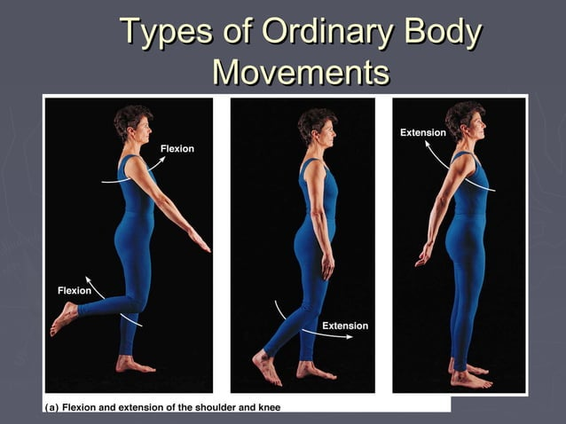

Slide 7
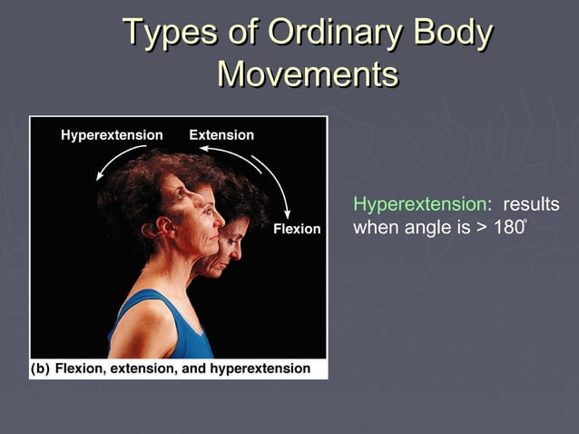

Slide 8
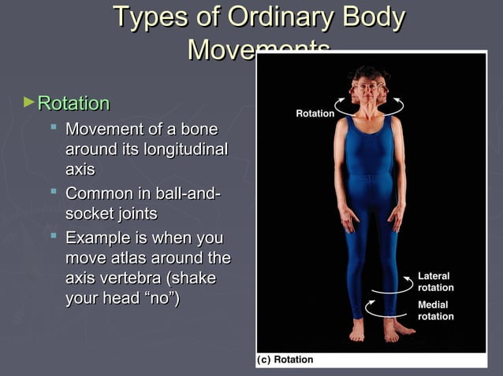

Slide 9
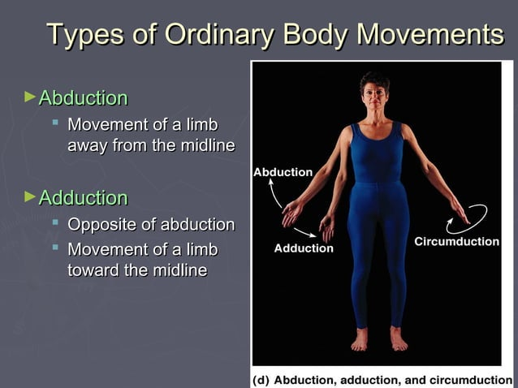

Slide 10
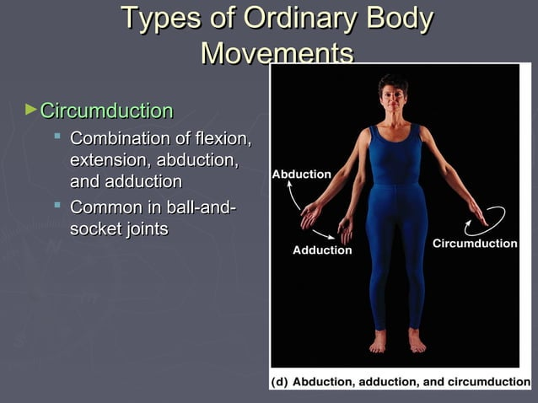

Slide 11
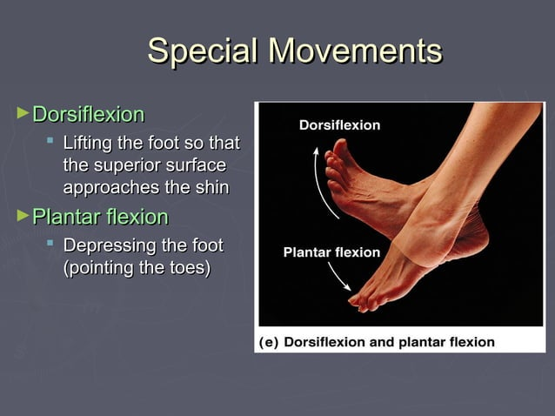

Slide 12
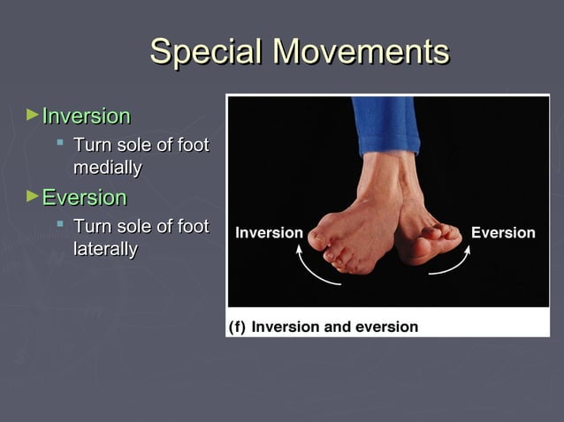

Slide 13
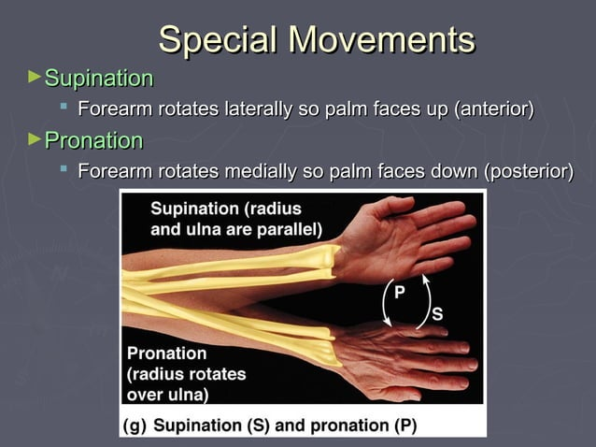

Slide 14
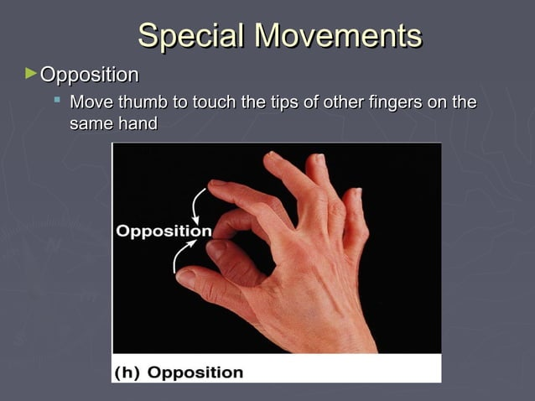

Slide 15
. Practice
Getting more confident using the English language starts with practise. The more you use the language, the less anxious you will feel when speaking.
2. Stay calm and speak slowly
You don’t need to rush to give your response – slow down your speech and give yourself the opportunity to find the right words!
3. Practice speaking with other non-native speakers
Do you feel uncomfortable around native speakers? Practice with non-native speakers instead!
If you’re nervous, just remember that other non-native speakers are probably just like you.
Nelson
It's important to remember that confidence is not something we're necessarily born with, but rather something that is learned and developed over time.

Slide 16
Utilize Body Language:
Non-verbal cues play a significant role in effective communication. Practice using appropriate gestures, maintaining eye contact, and maintaining an open posture while speaking in English. These non-verbal signals convey confidence and help you engage with others more effectively, making you feel more self-assured in the process.
Expand Your Vocabulary:
Building a strong vocabulary is crucial for expressing ideas confidently. Take the initiative to learn new words every day and use them in your conversations. By using diverse words, you not only convey your thoughts more precisely but also showcase your knowledge, inspiring self-assurance.
Focus on fluency, not accuracy initially: Initially, emphasize fluency over accuracy. This means you should prioritize keeping the conversation flowing, even if you occasionally make mistakes. Speaking confidently, expressing ideas, and making your point understood should be your primary goal.
Confidence in speaking English is a journey that requires practice and dedication. By improving your language skills, embracing mistakes, practicing with others, and visualizing success, you can gradually build your confidence.

